Slide 1
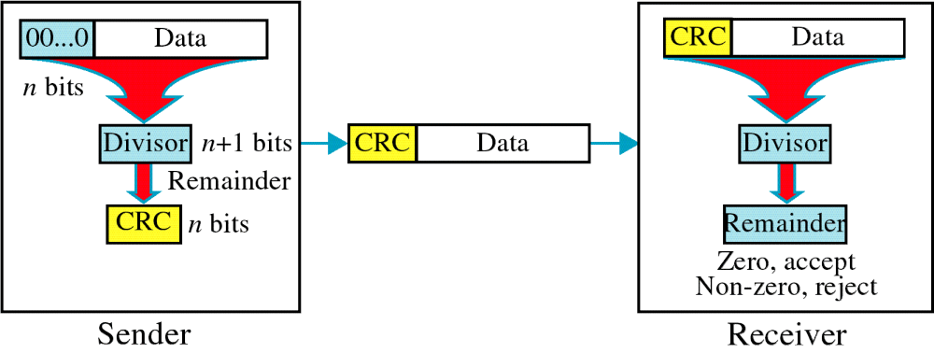
Figure 9-10
CRC
WCB/McGraw-Hill
© The McGraw-Hill Companies, Inc., 1998

Slide 2
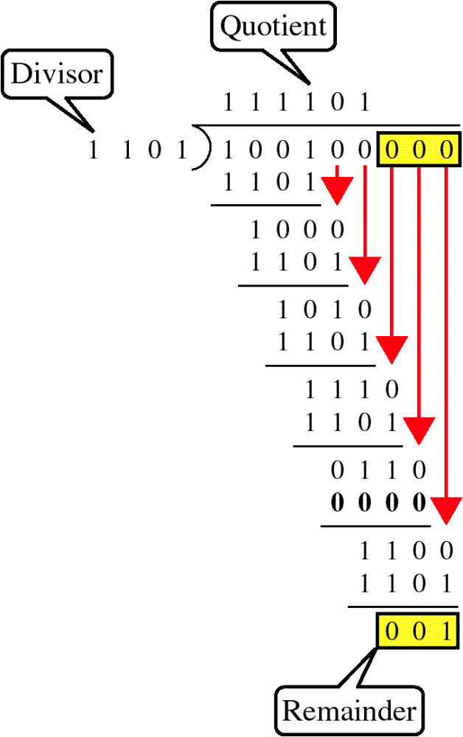
Figure 9-11
Binary Division
WCB/McGraw-Hill
© The McGraw-Hill Companies, Inc., 1998

Slide 3
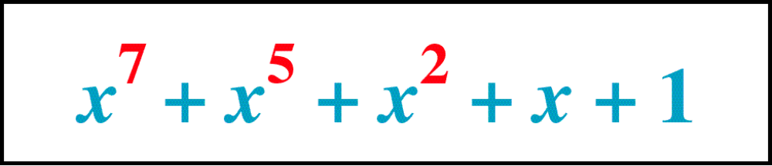
Figure 9-12
Polynomial
WCB/McGraw-Hill
© The McGraw-Hill Companies, Inc., 1998

Slide 4
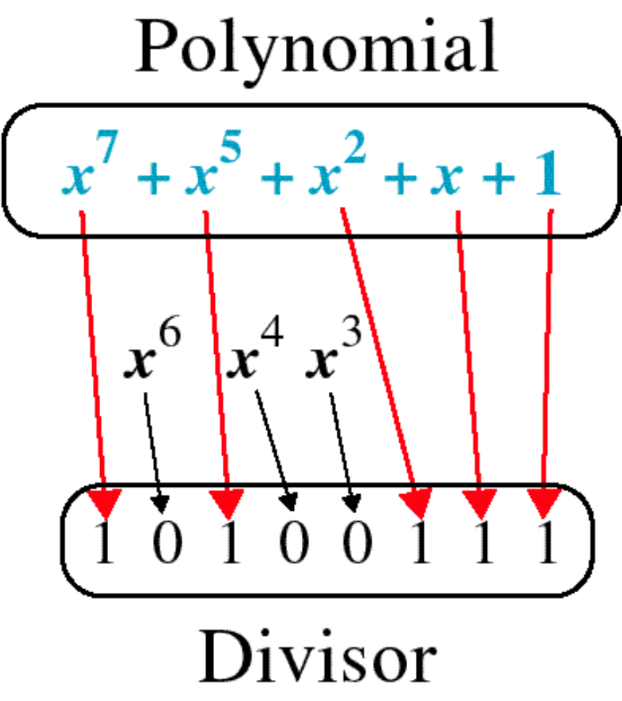
Figure 9-13
Polynomial and Divisor
WCB/McGraw-Hill
© The McGraw-Hill Companies, Inc., 1998

Slide 5
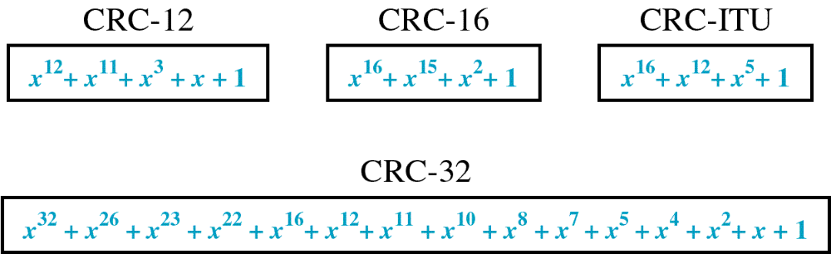
Figure 9-14
Standard Polynomials
WCB/McGraw-Hill
© The McGraw-Hill Companies, Inc., 1998

Slide 6
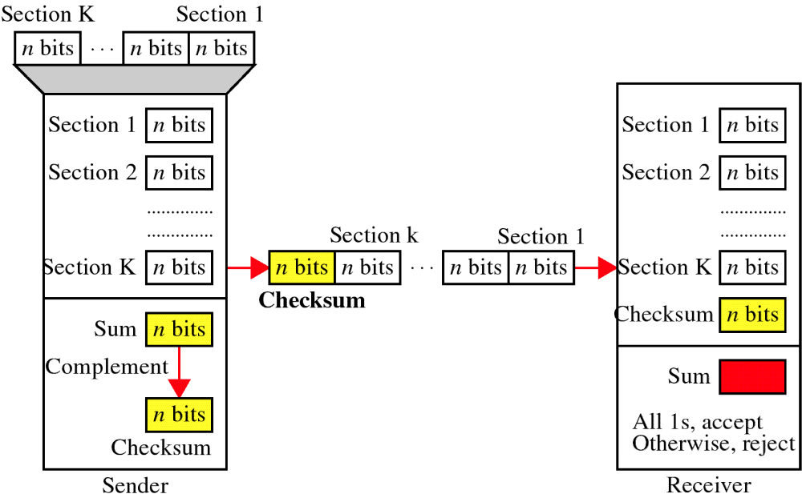
Figure 9-15
Checksum
WCB/McGraw-Hill
© The McGraw-Hill Companies, Inc., 1998

Slide 7
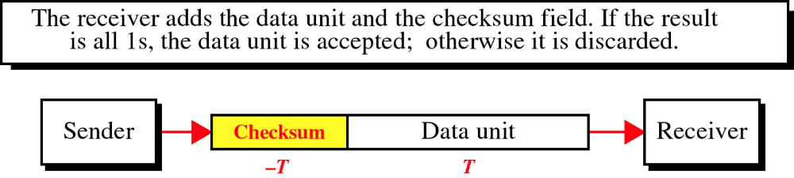
Figure 9-16
Data Unit and Checksum
WCB/McGraw-Hill
© The McGraw-Hill Companies, Inc., 1998

Slide 8
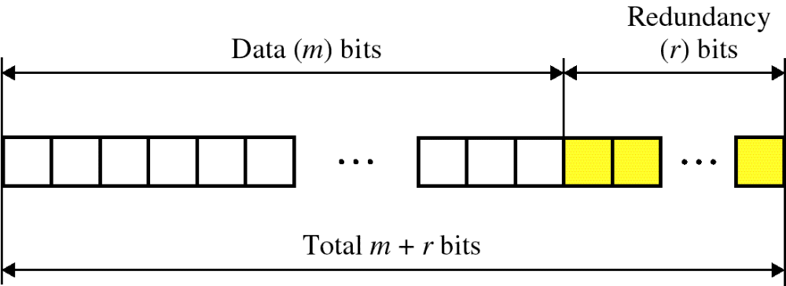
Figure 9-17
Error Correction
WCB/McGraw-Hill
© The McGraw-Hill Companies, Inc., 1998

Slide 9
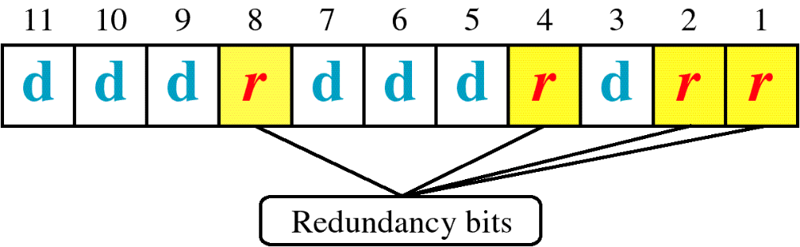
Figure 9-18
Hamming Code
WCB/McGraw-Hill
© The McGraw-Hill Companies, Inc., 1998

Slide 10
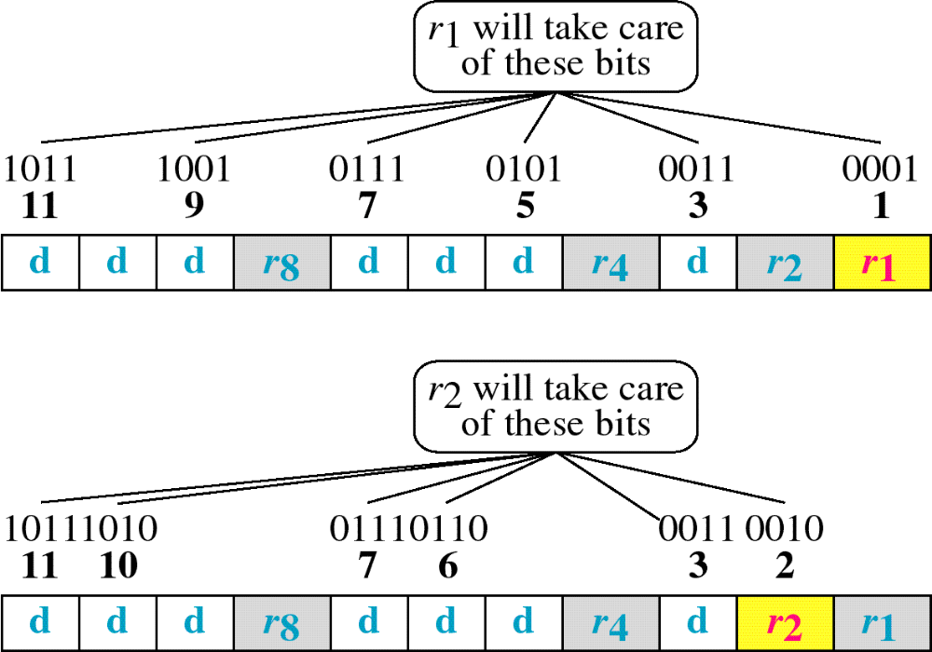
Figure 9-19
Hamming Code
WCB/McGraw-Hill
© The McGraw-Hill Companies, Inc., 1998

Slide 11
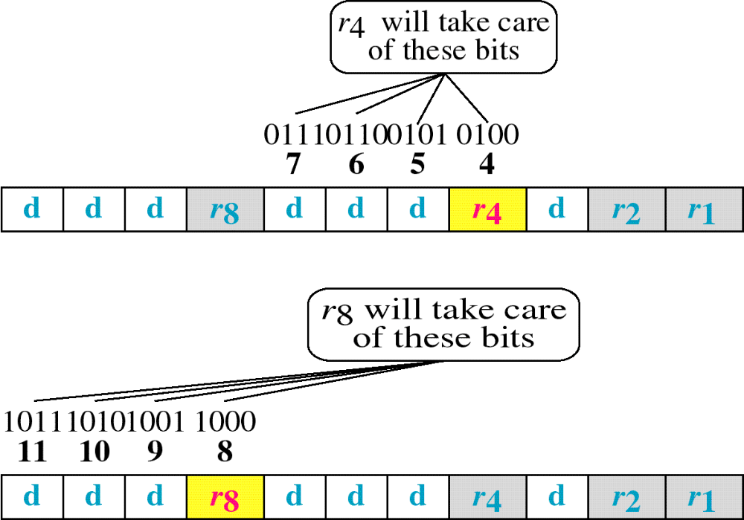
Figure 9-19-continued
Hamming Code
WCB/McGraw-Hill
© The McGraw-Hill Companies, Inc., 1998

Slide 12
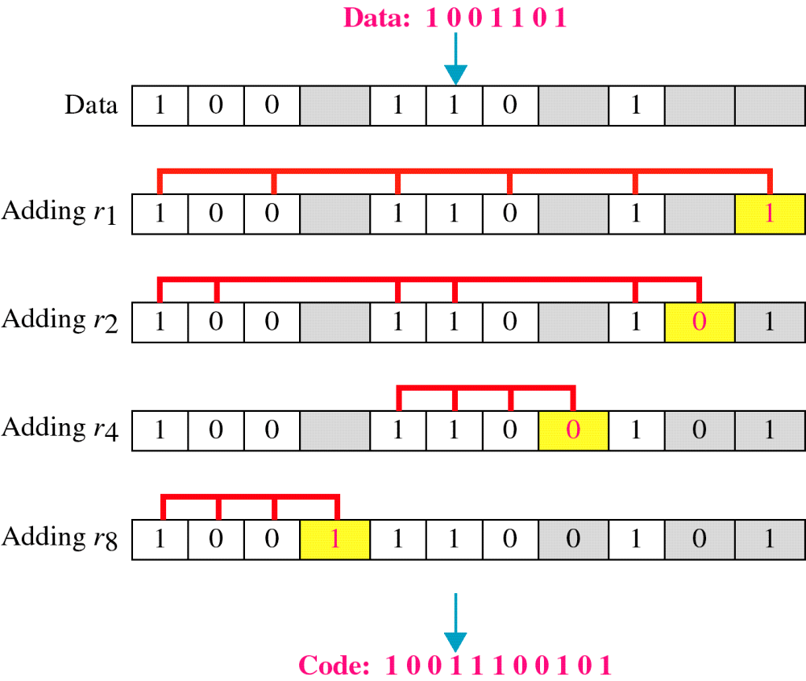
Figure 9-20
Example of Hamming Code
WCB/McGraw-Hill
© The McGraw-Hill Companies, Inc., 1998

Slide 13
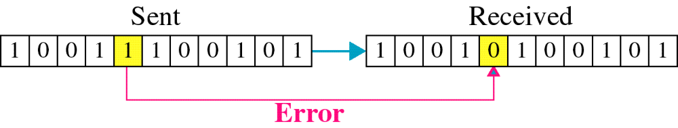
Figure 9-21
Single-bit error
WCB/McGraw-Hill
© The McGraw-Hill Companies, Inc., 1998

Slide 14

Figure 9-22
Error
Detection
WCB/McGraw-Hill
© The McGraw-Hill Companies, Inc., 1998

